Slide 1
Calculating missing side lengths from the area of composite rectilinear shapes
Perimeter and area

Slide 2
how to use Oak lessons

Slide 3
I can calculate a missing side length from the area of a composite rectilinear shape.

Slide 4
A composite rectilinear shape is a composite shape made from rectangles.

Slide 5

Calculating missing side lengths from the area of composite rectilinear shapes
Calculating area with missing side lengths
Finding a missing side length using the area
Working with perimeter and area

Slide 6
Calculating area with missing side lengths
A composite rectilinear shape may not have the length of every side shown.
In these situations, you may need to deduce the missing side length in order to find the area.

Slide 7
Calculating area with missing side lengths
Can we calculate the unknown length? How?
7 cm
15 cm
? cm

Slide 8
Calculating area with missing side lengths
Sometimes it’s easier to imagine the measurements all together.
15 - 7 = 8
The missing length is 8 cm.
7 cm
15 cm
? cm

Slide 9
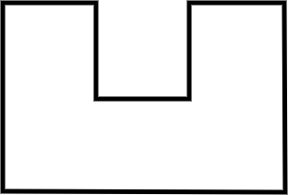
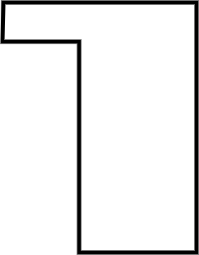
Calculating area with missing side lengths
4 cm
2 cm
3.3 cm
6 cm
6 cm
5 cm
2.7 cm
8 cm
2.6 cm
Area = 6 × 8 - 2 × 3.3
Area = 48 - 6.6
Area = 41.4 cm²
We could split the shape this way but then we have to work out two missing side lengths.

Slide 10
Calculating area with missing side lengths
4 cm
1 cm
2 cm
3.3 cm
6 cm
6 cm
5 cm
2.7 cm
8 cm
2.6 cm
Area = 6 × 8 - 2 × 3.3
Area = 48 - 6.6
Area = 41.4 cm²
Area = 2.6 × 5 + 1 × 4
Area = 13 + 4
Area = 17 cm²

Slide 11
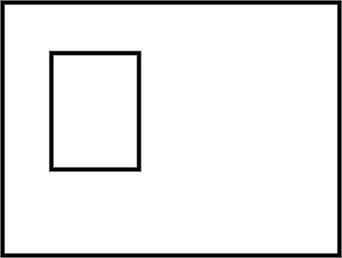
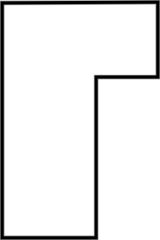
Calculating area with missing side lengths
1) Calculate the area of each composite rectilinear shape.
a) b)
12 m
3 m
16 m
2 m
11 m
17 m
5 m
4 m
5 m
19 m

Slide 12
Calculating area with missing side lengths
1) Calculate the area of each composite rectilinear shape.
a)
Area = 16 × 12 - 11 × 4
Area = 192 - 44
Area = 148 m²
12 m
16 m
11 m
5 m
4 m

Slide 13
Calculating area with missing side lengths
1) Calculate the area of each composite rectilinear shape.
b)
3 m
Area = 17 × 19 - 9 × 6
Area = 323 - 54
Area = 269 m²
2 m
9 m
11 m
17 m
6 m
5 m
19 m

Slide 14
Calculating missing side lengths from the area of composite rectilinear shapes
Calculating area with missing side lengths
Finding a missing side length using the area
Working with perimeter and area

Slide 15
Finding a missing side length using the area
Given the area of a composite rectilinear shape, it may be possible to calculate a missing side length.

Slide 16
Finding a missing side length using the area
Area = 54 cm²
2 cm
3 cm
5 cm
2 cm
x
Deduce what you can before starting on the area.

Slide 17
Finding a missing side length using the area
4 cm
Area = 54 cm²
Area = 18.4 cm²
y
3 cm
1 cm
2 cm
6 cm
5 cm
2 cm
x
3 cm
54 = 5x − 2 × 3
54 = 5x − 6
60 = 5x
12 = x
The missing length is 12 cm.
Deduce what you can before starting on the area.

Slide 18
Finding a missing side length using the area
4 cm
Area = 54 cm²
Area = 18.4 cm²
y
3 cm
1 cm
2 cm
6 cm
5 cm
2 cm
x
3 cm
54 = 5x − 2 × 3
54 = 5x − 6
60 = 5x
12 = x
The missing length is 12 cm.
18.4 = y + 6 × 3
18.4 = y + 18
0.4 = y
The missing length is 0.4 cm.

Slide 19
Finding a missing side length using the area
1) Calculate the length of the marked side.
a) b)
18 cm
23 cm
4 cm
13 cm
7 cm
h
2 cm
t
Area = 309 cm²
Area = 187 cm²

Slide 20
Finding a missing side length using the area
1) Calculate the length of the marked side.
a)
18 cm
309 = 23 × 11 + 7h
309 = 253 + 7h
56 = 7h
8 = h
The marked side is 8 cm long.
23 cm
7 cm
h
11 cm
Area = 309 cm²

Slide 21
Finding a missing side length using the area
1) Calculate the length of the marked side.
b)
187 = 13t − 4 × 2
187 = 13t − 8
195 = 13t
15 = t
The marked side is 15 cm long.
4 cm
13 cm
2 cm
t
Area = 187 cm²

Slide 22
Calculating missing side lengths from the area of composite rectilinear shapes
Calculating area with missing side lengths
Finding a missing side length using the area
Working with perimeter and area

Slide 23
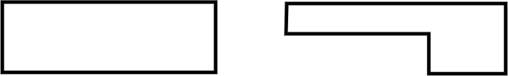
Working with perimeter and area
Different composite rectilinear shapes may have the same perimeter or area yet look completely different.
What do you notice about these two shapes?

Slide 24
Working with perimeter and area
These shapes have the same perimeter but different areas.

Slide 25
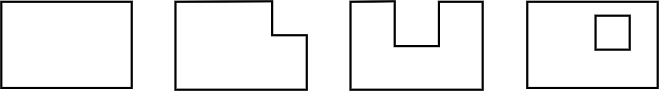
Working with perimeter and area
1) Which shapes have the same area? Which have the same perimeter?
a) b) c) d)
3 mm
3 mm
3 mm
3 mm
3 mm
3 mm
8 mm
8 mm
8 mm
8 mm
10 mm
10 mm
10 mm
10 mm

Slide 26
Working with perimeter and area
1) Which shapes have the same area? Which have the same perimeter?
a) b) c) d)
3 mm
3 mm
3 mm
3 mm
3 mm
3 mm
8 mm
8 mm
8 mm
8 mm
10 mm
10 mm
10 mm
10 mm
Shape A has an area of 80 mm². Shapes B, C and D all have the same area of 71 mm².

Slide 27
Working with perimeter and area
1) Which shapes have the same area? Which have the same perimeter?
a) b) c) d)
3 mm
3 mm
3 mm
3 mm
3 mm
3 mm
8 mm
8 mm
8 mm
8 mm
10 mm
10 mm
10 mm
10 mm
Shapes A and B both have a perimeter of 36 mm. Shape C has a perimeter of 42 mm.
Shape D is ambiguous - do you want to include the square or not?

Slide 28
Working with perimeter and area
When calculating perimeter or area for composite rectilinear shapes, it can be more efficient to consider manipulating the shape.

Slide 29
Working with perimeter and area
Match the word to its definition
perimeter size of the surface
area distance around a 2D shape
length measurement between two points

Slide 30
Calculating missing side lengths from the area of composite rectilinear shapes
A composite rectilinear shape may not have the length of every side shown.
In these situations, you may need to deduce the missing side length in order to find the area.
Given the area of a composite rectilinear shape, it may be possible to calculate a missing side length.

Slide 31

© Oak National Academy 2024.
Produced in partnership with Mathematics in Education and Industry.
Licensed on the Open Government Licence v3.0, except where otherwise stated. See Oak terms and conditions.

